Slide 1


Computer Organization & Architecture
Chapter 11
Instruction Sets:
Addressing Modes and Formats

Slide 2
11.1 Addressing types
Def.: a method to determine the data address in the current instruction or next instruction address
  Depends on CPU hardware and affects instruction format and function
Two types
  Instruction addressing
    Sequence addressing
    Jump addressing
  Data addressing

Slide 3
Addressing Modes
  Immediate
  Direct
  Indirect
  Register
  implicit
  Register Indirect
  Displacement (Indexed)
  Stack

Slide 4
Immediate Addressing
  Operand is part of instruction, Operand = address
  e.g. ADD 5
      Add 5 to contents of accumulator
      5 is operand
  When it is loaded into a data register, the sign bit is extended to the left to fulfill data word size
  The simplest addressing mode, no need to access memory or cache
    Fast
    Limited range
  Applications:
    Define and use constants
    Set initial values of variable

Slide 5
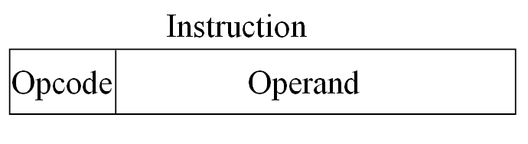
Immediate Addressing Diagram
mode

Slide 6
Direct Addressing
  Address field contains effective address of operand
  Effective address (EA) = address field (A)
  e.g. MOV AX, [1070H]
    Move the content of address 1070H to AX
    1070H is a memory address.
  Single memory reference to access data
  No additional calculations to work out effective address
  Limited address space

Slide 7
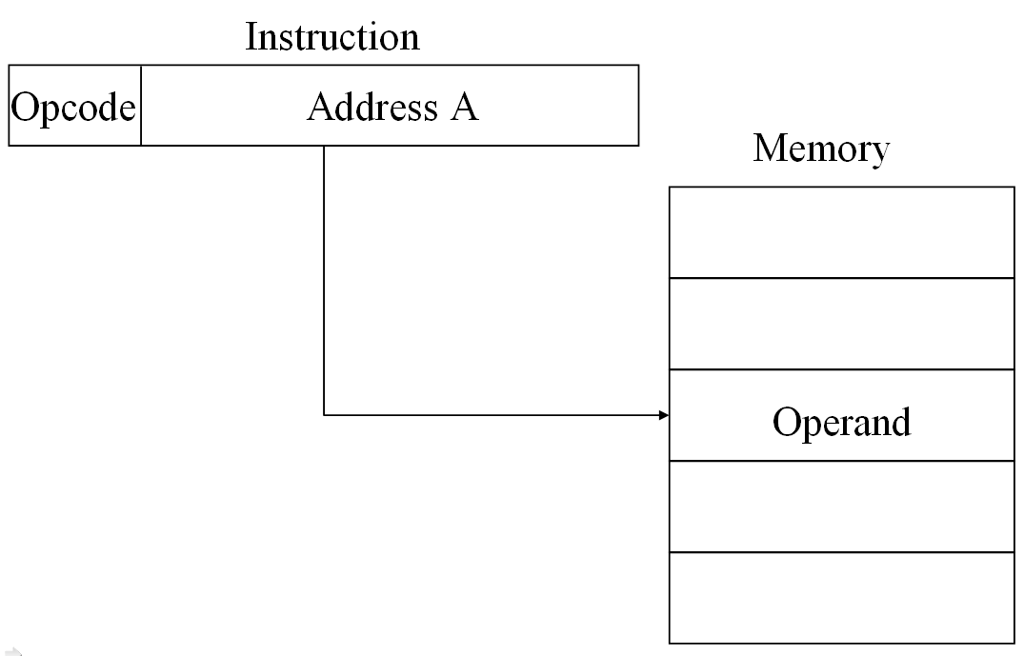
Direct Addressing Diagram

Slide 8
Implicit Addressing
  The address of operand is not explicitly presented, it hides in the opcode or a special register, such as AC
    ADD 5

Slide 9
Indirect Addressing
  Memory cell pointed to by address field contains the address of (pointer to) the operand
  EA = (A)
    Look in A, find address (A) and look there for operand
  e.g. load (A)
    load the content of the address that the content of memory address A point to accumulator AC.

Slide 10
  Large address space
  2^{n} where n = word length
  May be nested, multilevel, cascaded
    e.g. EA = (((A)))
      No gains
      Draw the diagram yourself
  Multiple memory accesses to find operand
  Hence slower

Slide 11
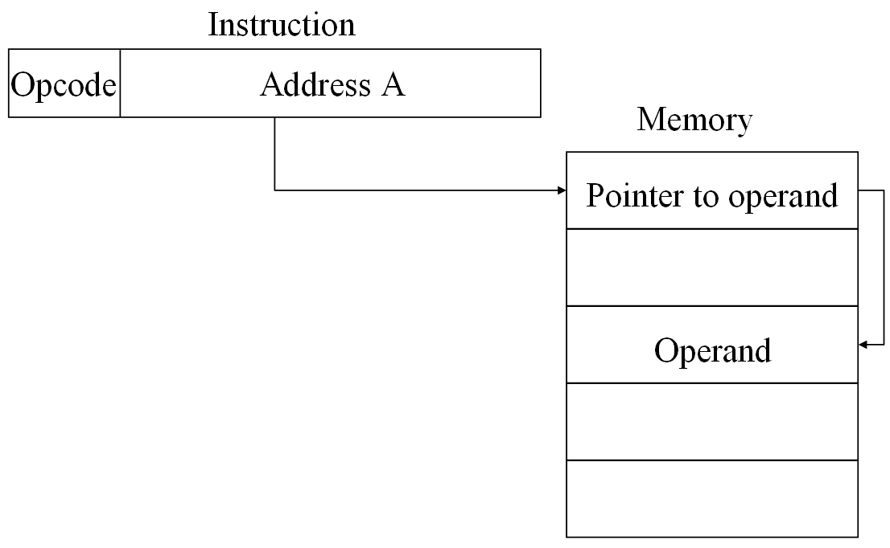
Indirect Addressing Diagram

Slide 12
Register Addressing
  Operand is held in register named in address filed
  EA = R
  Limited number of registers
  Very small address field: 3~4bits
    Shorter instructions
    Faster instruction fetch

Slide 13
  No memory access
  Very fast execution
  Very limited address space
  Programmer decides which values should remain in registers and which should be stored in main memory
  For the variables used frequently, you’d better define them as register variable.
    E.g. register int i,j;

Slide 14
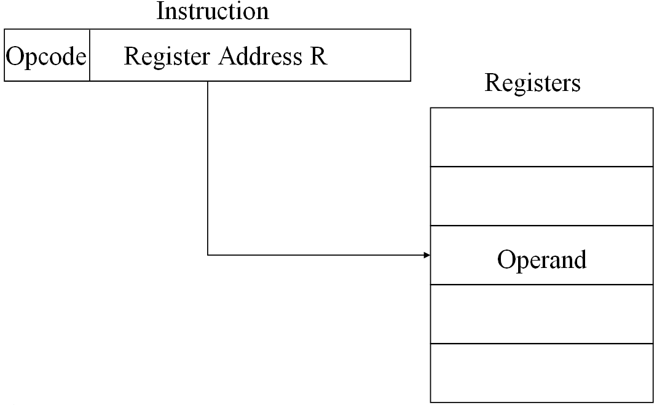
Register Addressing Diagram

Slide 15
Register Indirect Addressing
  Similar to indirect addressing (address in register)
  EA = (R)
  Operand is in memory cell pointed to by contents of register R
  Large address space (2^{n})
  One fewer memory access than indirect addressing

Slide 16
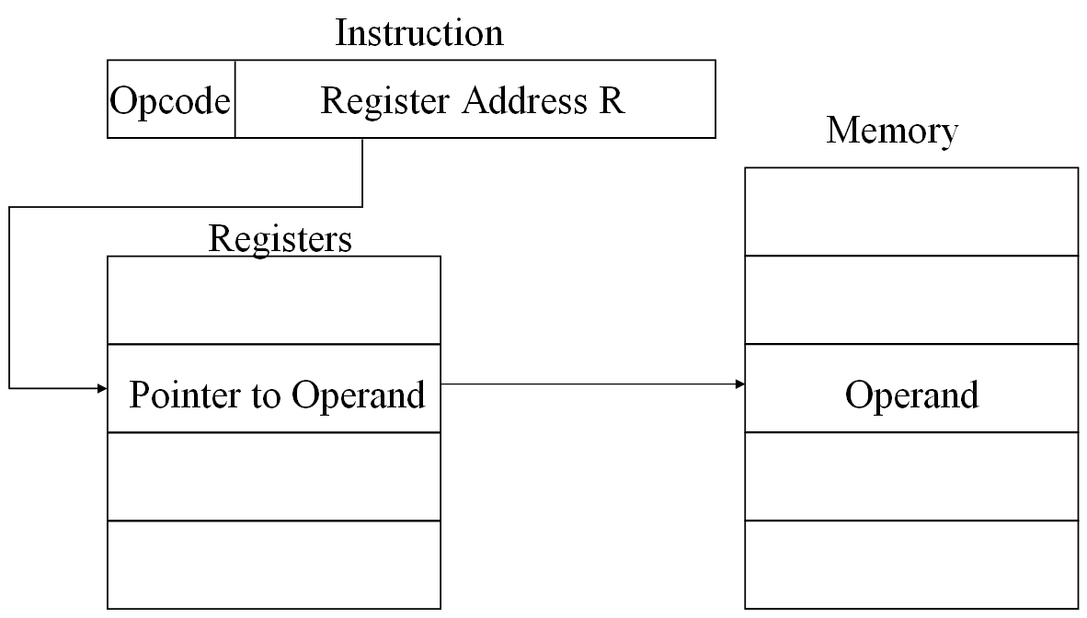
Register Indirect Addressing Diagram

Slide 17
Displacement Addressing
  A very powerful mode of addressing
  direct address + register indirect addressing
  EA = A + (R)
  Address field hold two values
    A = base value
    R = register that holds displacement
    or vice versa

Slide 18
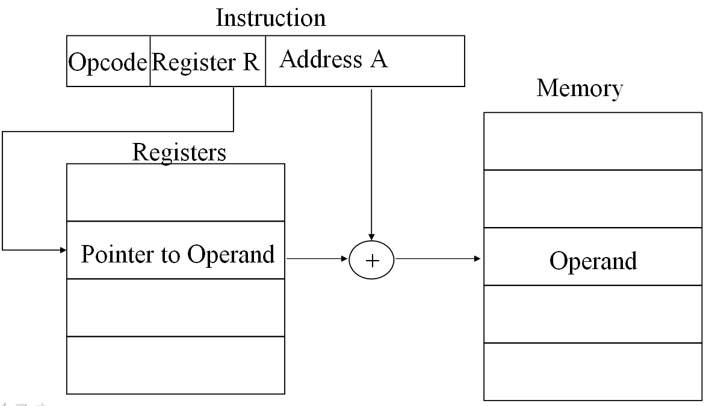
Displacement Addressing Diagram

Slide 19
The Most Common Uses of Displacement Address
  Relative Addressing
  Base-register Addressing
  Indexing

Slide 20
Relative Addressing
  A version of displacement addressing
  R = Program counter, PC
  EA = A + (PC)
    A is displacement, treated as complement
    The effective address is a displacement relative to the address of current instruction
  i.e. get operand from A cells from current location pointed to by PC
  Used for jump

Slide 21
Base-Register Addressing
  EA = A + (R)
    A holds displacement
    R holds base address
  R may be explicit or implicit
    e.g. segment registers in 80x86
  Used for address transform by OS

Slide 22
Indexed Addressing
  A = base
  R = displacement
  EA = A + R
  Good for accessing arrays or loop programming
    EA = A + R
    R++

Slide 23
Direct addressing vs. index addressing
Sum of 100 numbers
Load AC D
Add D+1
Add D+2
…
Add D+99
Load X 0
Add X, D
INX
CPX 99
BNE M
M
AC=AC+[D+(X)]
Direct addressing
Index addressing

Slide 24
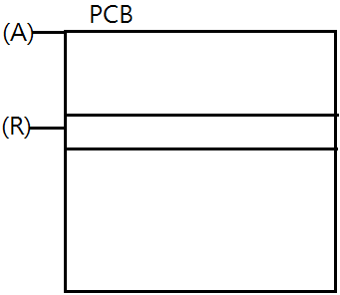
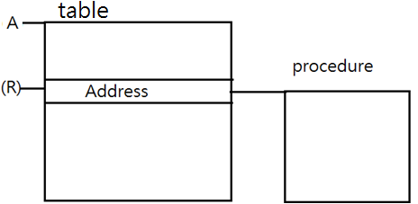
Combinations
  Post-index
  EA = (A) + (R)
    Content of A + content of R
    Used for accessing data block
  Pre-index
  EA = (A+(R))
    A+ content of R
    Accessing table

Slide 25
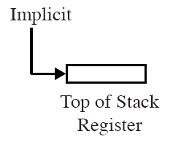
Stack Addressing
  Operand is (implicitly) on top of stack
  e.g.
    Pop OPR Pop top two items from stack
    to OPR

Slide 26
  Two implement modes of stack:
    Hard stack: registers
    Soft stack: memory
  Top is pointed by SP register
  Stack addressing is an implicit addressing
  The same as register indirect

Slide 27
11.3 Instruction Formats
Defining Layout of bits in an instruction
Includes opcode
Includes (implicit or explicit) operand(s)
  Pop, addressing modes
Usually more than one instruction format in an instruction set

Slide 28
Instruction Length
  Affected by and affects:
    Memory size
    Memory organization
    Bus structure
    CPU complexity
    CPU speed
  Trade off between powerful instruction repertoire and saving space
    Programmers want more opcodes, more operands, more addressing modes and great address space, these results in longer instruction length. But longer instruction length may be wasteful

Slide 29
Allocation of Bits
  For a given instruction length, there is clearly a trade-off between the number of opcode and the power of the addressing capability
    Variable-length opcodes, using an additional bit indicates it
  Variable-length instructions
    Flexibility
    Complicated CPU

Slide 30
Comment
For high level language programmer, the contents of this chapter are almost useless
For assembly programmer, they are necessary
Necessary for instruction system designer
Necessary for people of computer major

Slide 31
Vocabulary
Autoindexing: 自动变址
Effective address: 有效地址
Displacement addressing: 偏移寻址
Indexing: 变址
Instruction format: 指令格式
Relative addressing: 相对寻址
Postindexing: 后变址
Preindexing: 前变址

Slide 32
Key points
Common addressing modes
PII addressing modes
PII instruction format

